Slide 1
Market Magician Algorithmic Trader
Artificial Asynchrony
CS691
Dec 2024
Notes:
Kassandra

Slide 2
Agenda
✅
Project Description
Working Schedule
Minimum Viable Product
Technologies and Algorithms
Product Diagrams
Previous Sprint Recap
Product and Current Sprint Backlog
Sprint Metrics
Demo and API
Notes:
Kassandra

Slide 3
Roles and Responsibilities
Kassandra Camarillo | Team Leader
Henry Kim | Scrum Master
Abed Mussawi | Developer
Andrew Rowan | Developer
Aviel Sánchez | Developer
Notes:
Everybody

Slide 4
Problem Statement
Currently, there is a lot of interest in the stock market. Sometimes it could be confusing and daunting to invest money in the stock market since there is a lot of information and it is difficult to access. Our application will make it much easier and more accessible to the greater public to invest more wisely and with the power of data at their back.

Slide 5
Project Description
An AI that uses historical data, news flow, and intra-day trading data to determine entry and exit points of a stock or fund using a trained regression model in order to maximize profits.
This is for Daily traders and Investors
who want to improve predictive capabilities,
the webb App is a tool to help both large and small capital investors and traders predict market trends faster than a human could.
This subscription service unlike hedge funds, where you need to pay a lot of money out of pocket to manage your investments, or risk trading personal funds with untested strategies,
our application provides an easy way to invest and trade your securities to minimize risk and maximize profits
Notes:
Kassandra record

Slide 6
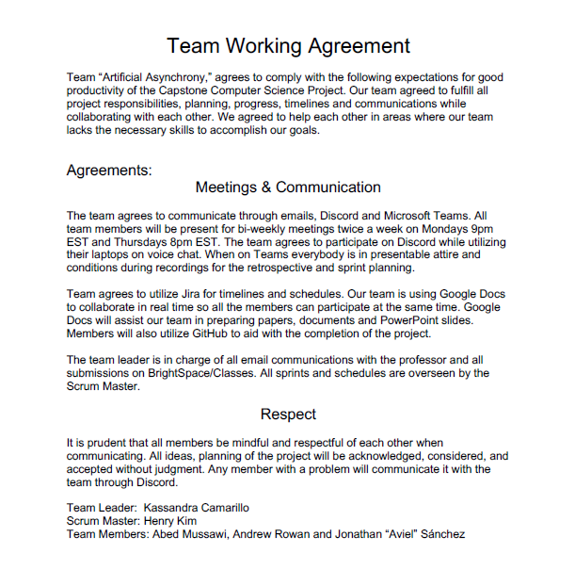
Team Working Agreement
Notes:
Aviel

Slide 7
Project Schedule
Meeting Cadence
Twice a week (Mon, Thur)
Additional meetings scheduled ad hoc based on team needs
Text Based Daily Scrum
Asynchronous team makes daily scrums impractical
Substitute with text based check in
Notes:
Aviel

Slide 8

Alex Woods - Retail Investor
Age: 23
Location: Arlington, Virginia
Occupation: Nurse / recent graduate
Alex is a recent graduate who wants to start investing but has limited money and a bit of experience. She is looking for an affordable and user friendly platform that can help her enter the investment world without the need for deep financial knowledge.
Using our app will offer her personalized and ease to use market data which will make investing more accessible for beginners like Alex.
Notes:
Abed

Slide 9

Jaylen Washington - Financial Advisor
Age: 33
Location: Austin, Texas
Occupation: Financial Advisor
Jaylen is a financial advisor who assists individuals with decisions about their money. He offers advice on investments, taxes, and insurance.
Using our app will offer him a useful analysis tool that supplements his advisement strategy with AI backed assessments. This could cut down on his research and analysis, saving time and money.
Notes:
Abed

Slide 10

James Smith - Hedge Fund Manager
Age: 35
Location: San Francisco, California
Occupation: hedge fund manager
James is an experienced hedge fund manager and is always on the look up for new and innovative tools to enhance his investment strategies. James understands that now a days AI models are important tools and are more efficient than using traditional methods.
Using our app will offer him cutting edge algorithms and data analysis which can be a great asset to a better investment in combination with his expertise.
Notes:
Abed

Slide 11
Minimum Viable Product
The most important capability of the application is the stock price prediction
This prediction relies on a good model
Therefore, MVP for Market Magician must do the following
Train a model based on selected stock price history
Predict future prices for selected stock
Notes:
Andrew

Slide 12
Technologies
Python
JavaScript
Machine Learning
TensorFlow
Keras
Django
HTML
CSS
Reactjs
PostgresSQL
Y!finance
Github
VSCode
Notes:
Andrew

Slide 13
Algorithms
✅
Linear Regression
Simplest to implement
Poor Prediction Capabilities
Ultimately abandoned
Long-Short Term Memory
Deep Learning Algorithm for time-series data
Current implementation is a basic model
Much more room for improvement
Monte Carlo Simulation
Random simulation learning for data science
Currently being tested for implementation
Notes:
Andrew

Slide 14
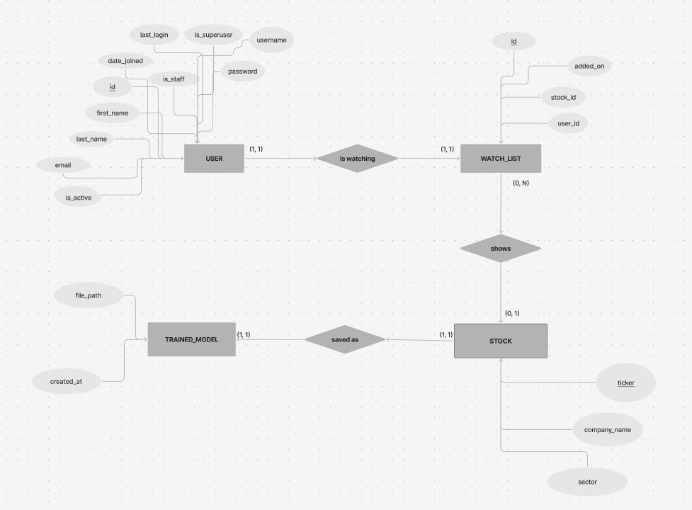
Entity-Relationship Diagram
✅
Notes:
Abed

Slide 15
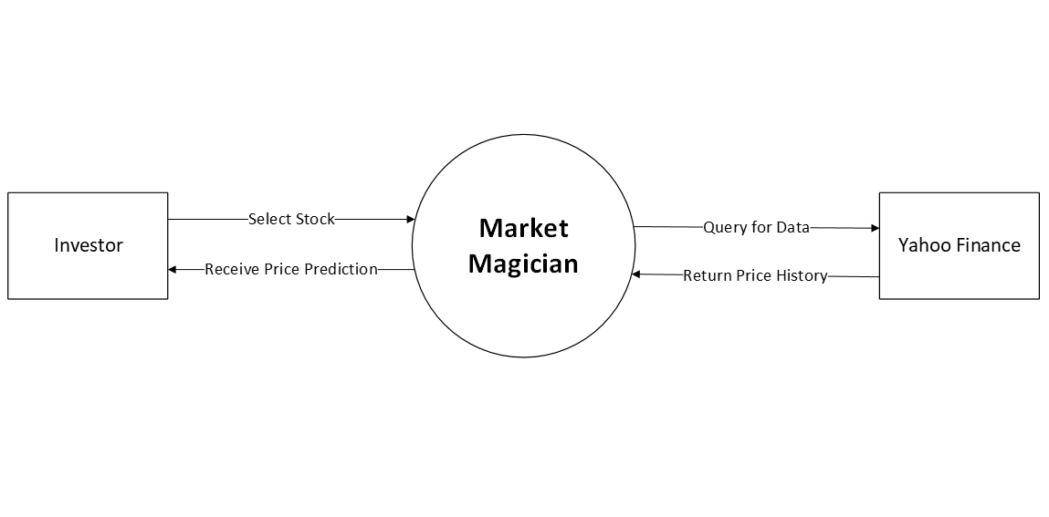
Context Diagram
Notes:
Abed

Slide 16
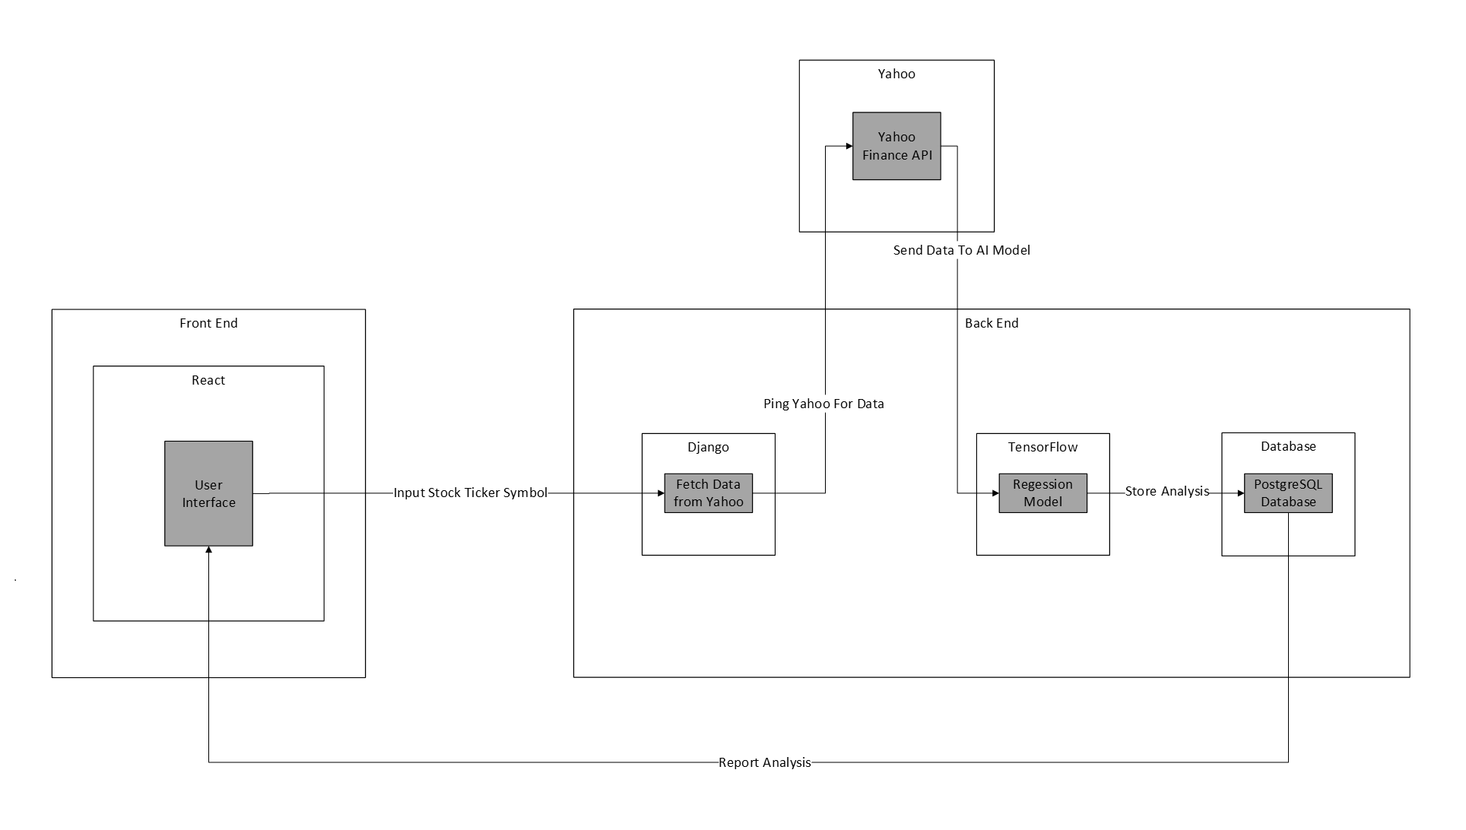
Architecture Diagram
Notes:
abed

Slide 17
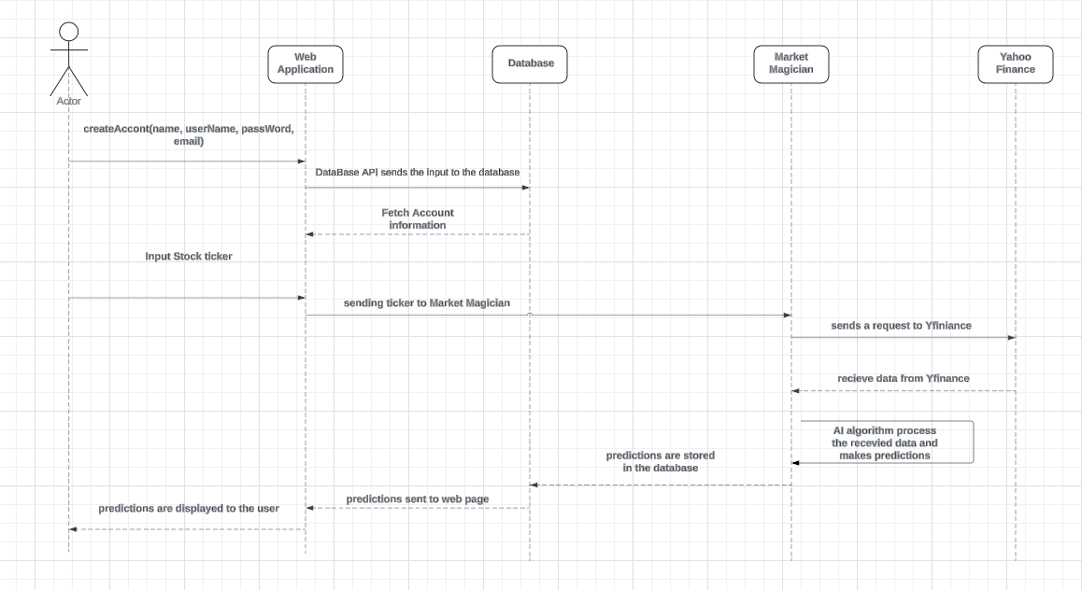
Sequence Diagram
Notes:
abed

Slide 18
Sprint 2 Recap
✅
Combined front and back end into single application
Separated training and prediction functions
Improved speeds for displaying prediction
Added login and signup (front end only)
Notes:
henry

Slide 19
Product Backlog
✅
No major changes to product backlog
Single story added for CSS task
Notes:
Henry

Slide 20
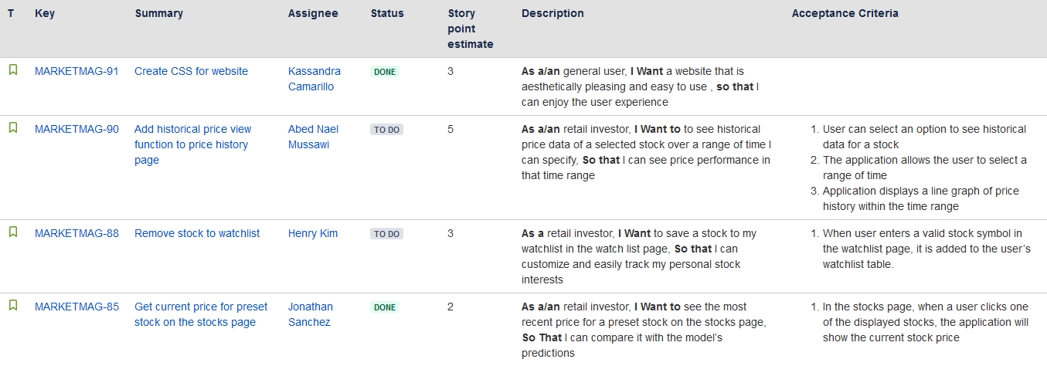
Product Backlog

Slide 21
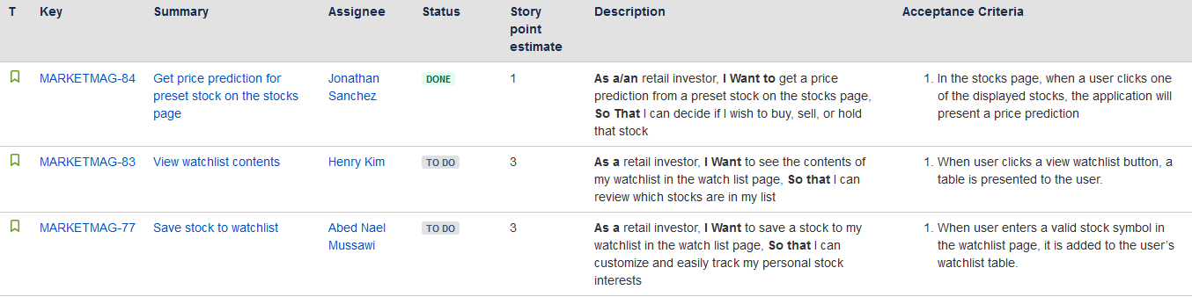
Product Backlog

Slide 22
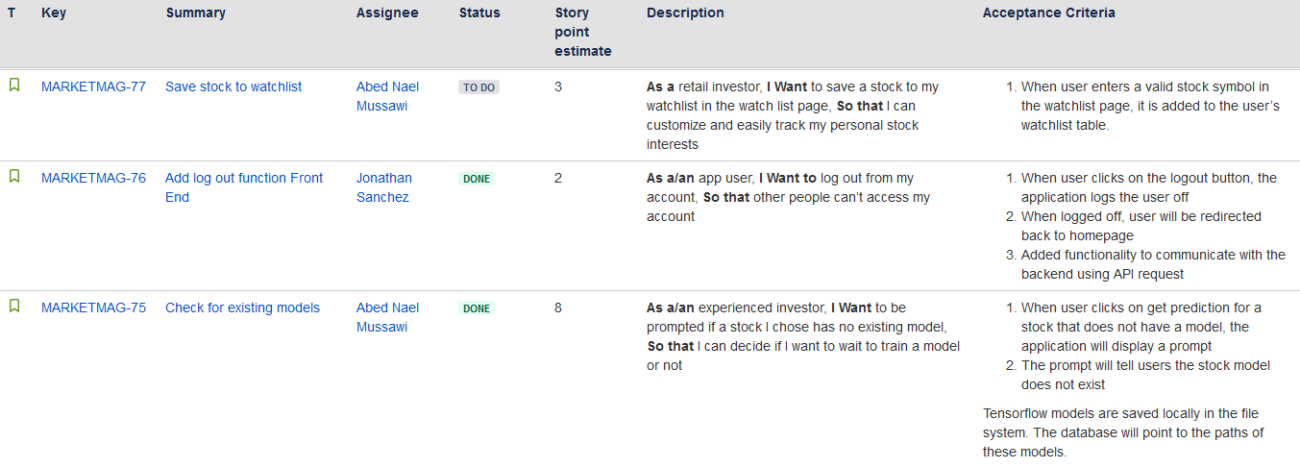
Product Backlog

Slide 23
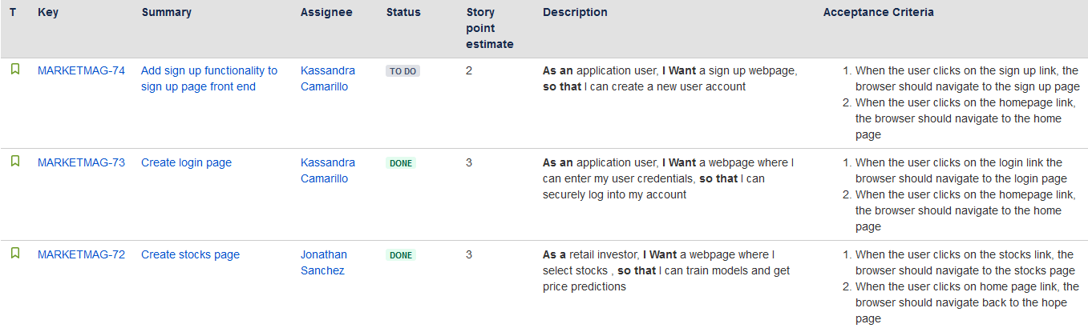
Product Backlog
Notes:
Andrews start

Slide 24
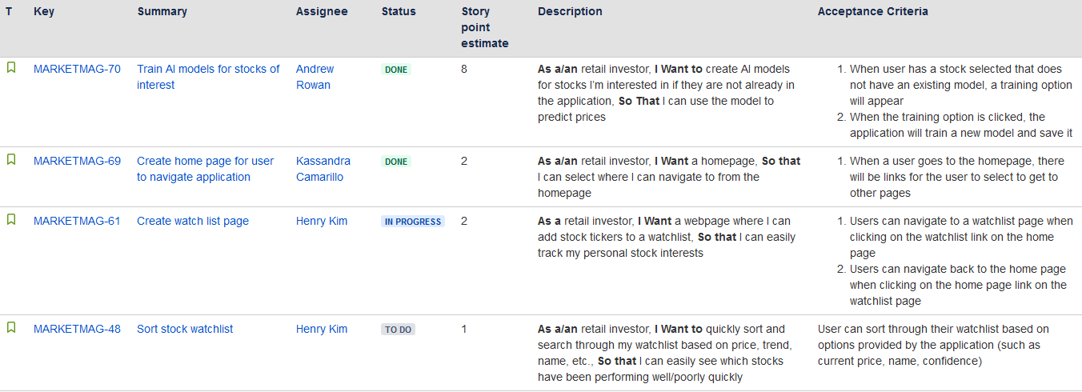
Product Backlog

Slide 25
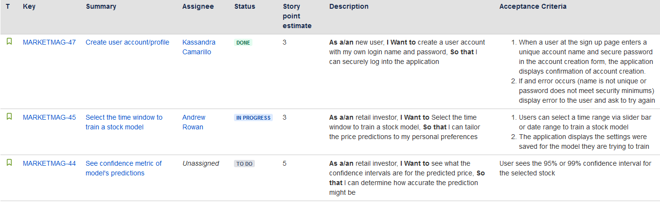
Product Backlog

Slide 26
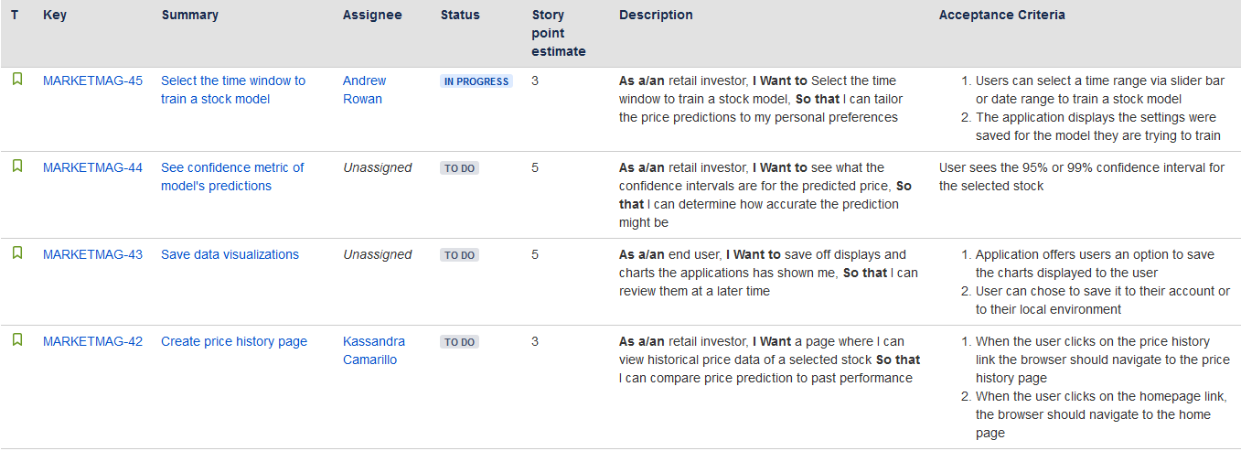
Product Backlog

Slide 27
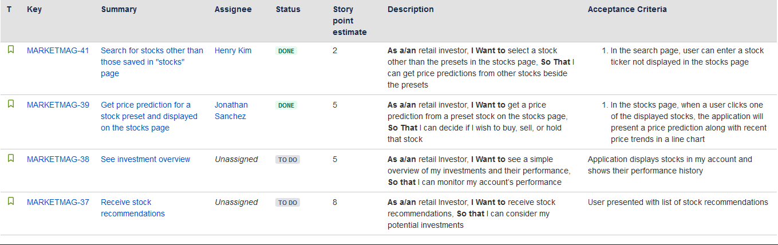
Product Backlog

Slide 28
Sprint 3 Backlog
✅
Planned similar workload to sprint 2
Did not account for lower capacity
Holiday Season
Individual Assignments
Finals Week
Notes:
Henry

Slide 29
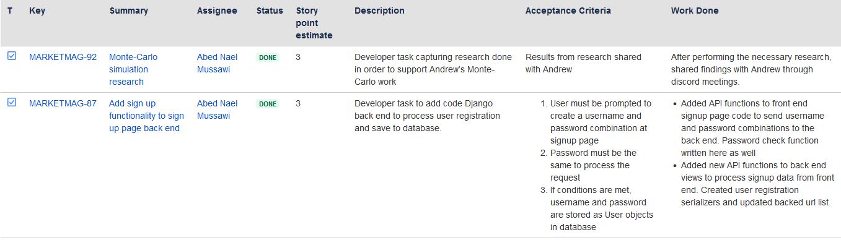
Sprint 3 Backlog - Abed
Notes:
abed

Slide 30
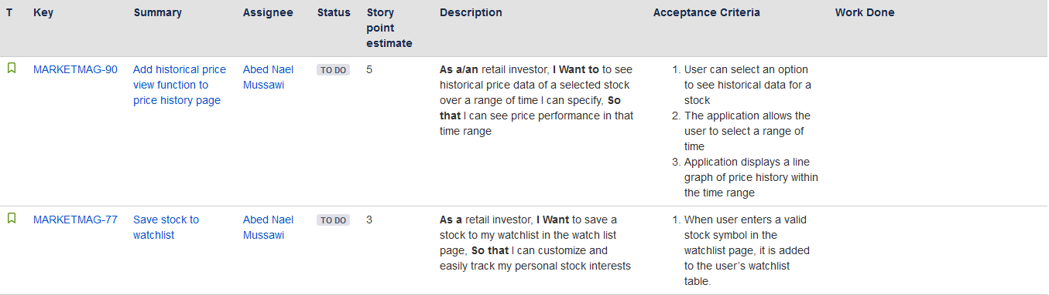
Sprint 3 Backlog - Abed

Slide 31
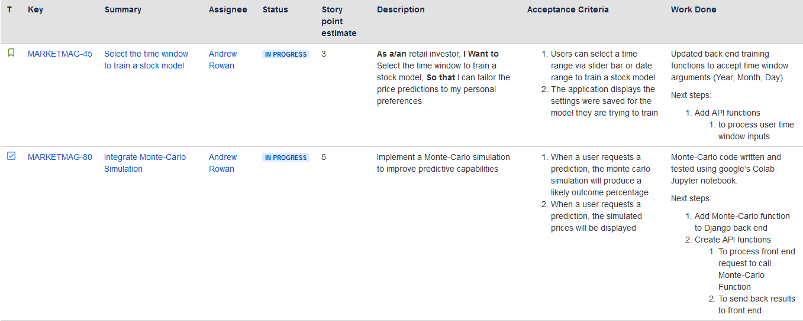
Sprint 3 Backlog - Andrew

Slide 32
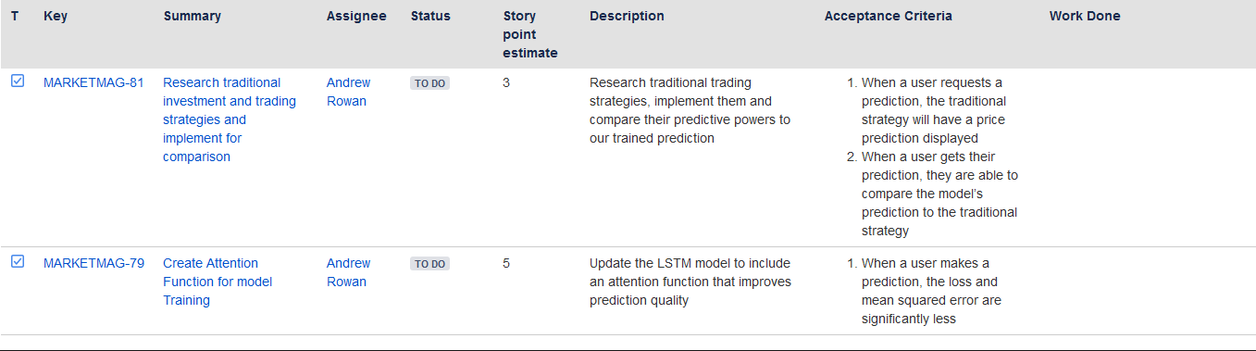
Sprint 3 Backlog - Andrew

Slide 33
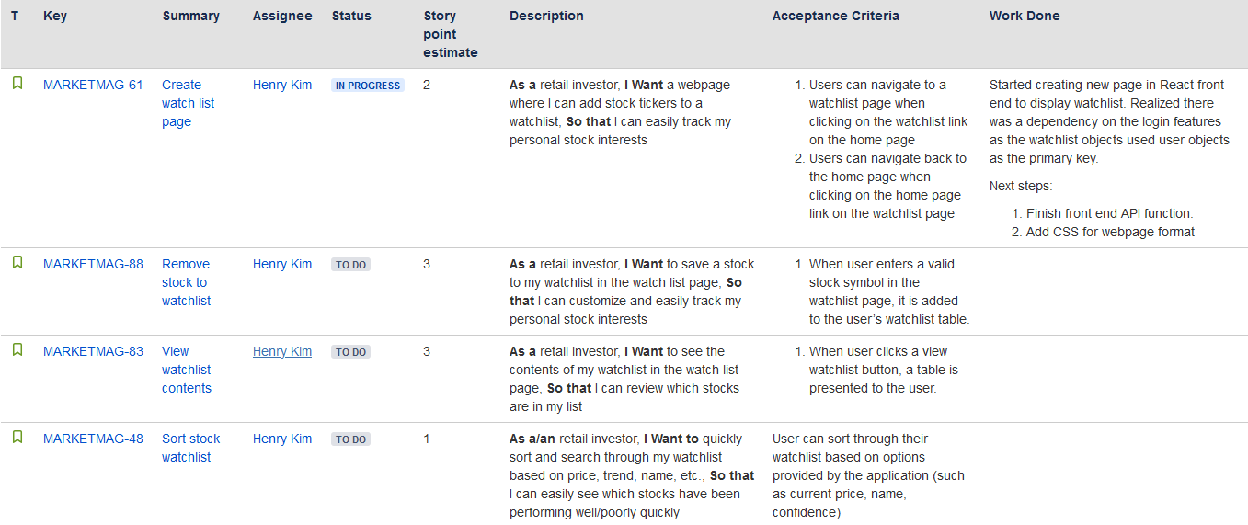
Sprint 3 Backlog - Henry

Slide 34
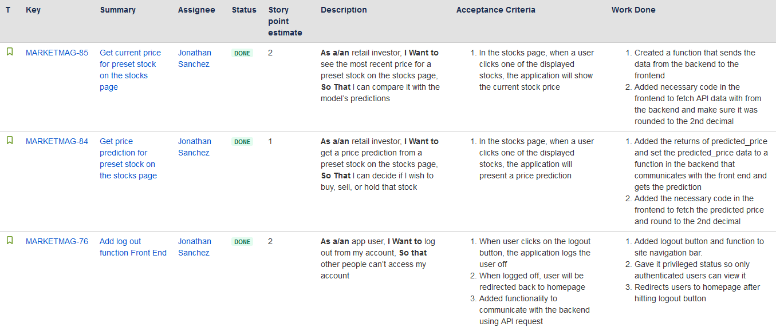
Sprint 3 Backlog - Aviel

Slide 35
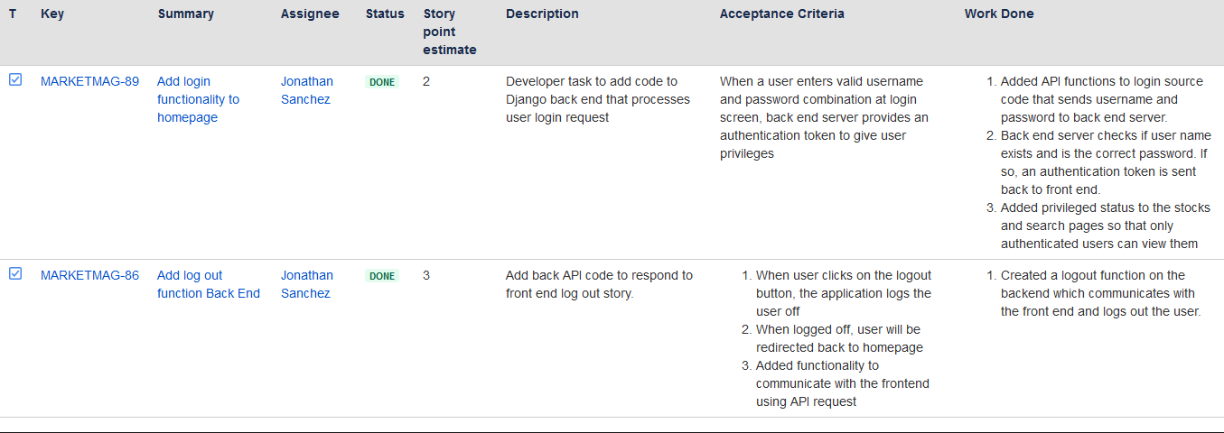
Sprint 3 Backlog - Aviel

Slide 36
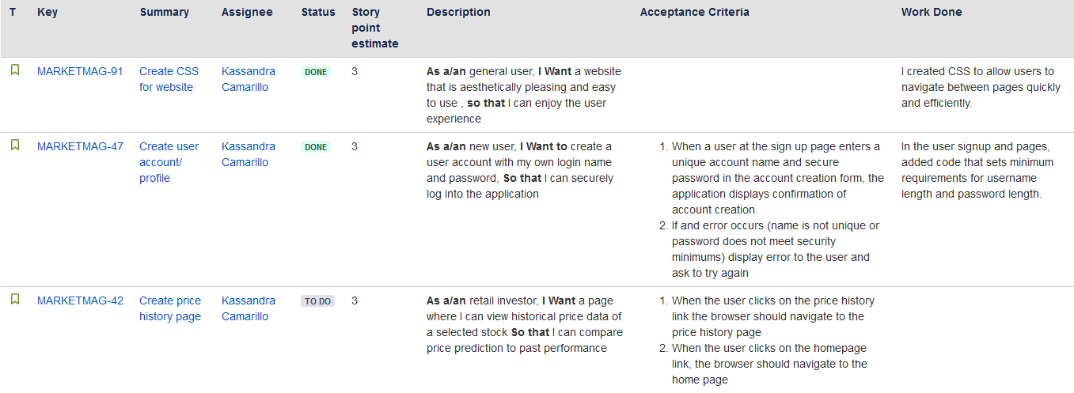
Sprint 3 Backlog - Kassandra

Slide 37
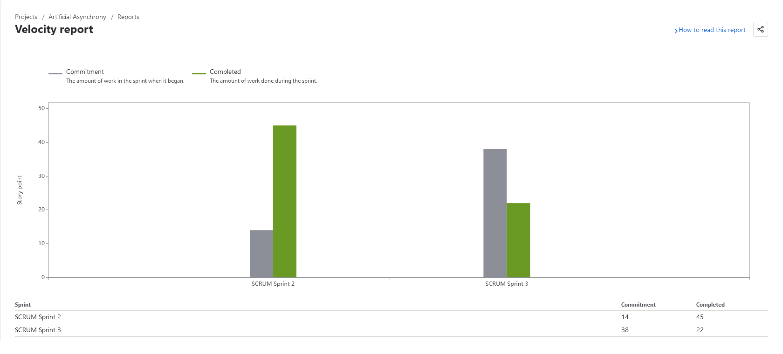
Metrics - Velocity
✅
Notes:
henry

Slide 38
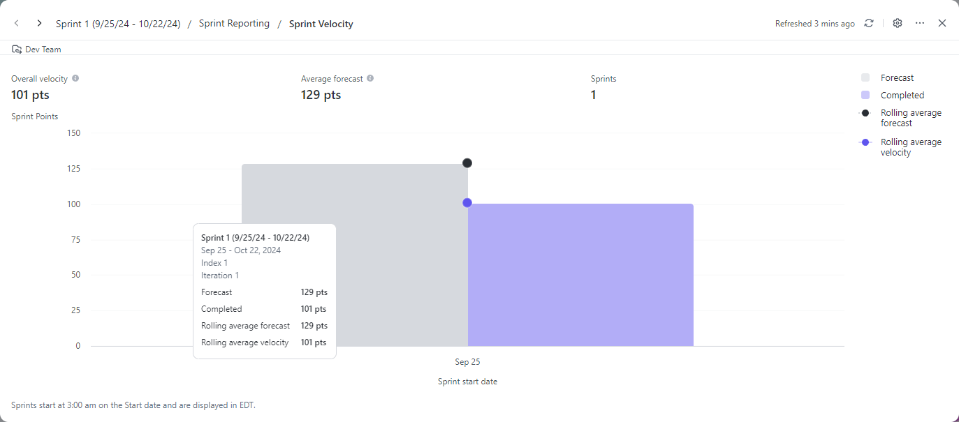
Metrics - Velocity Sprint 1
✅

Slide 39
Velocity Notes
Sprint started automatically by syllabus date
Committed points before Sprint planning
Actual committed points: 58
Lower velocity due to capacity miscalculation
Sprint 1 velocity was measured using different tool

Slide 40
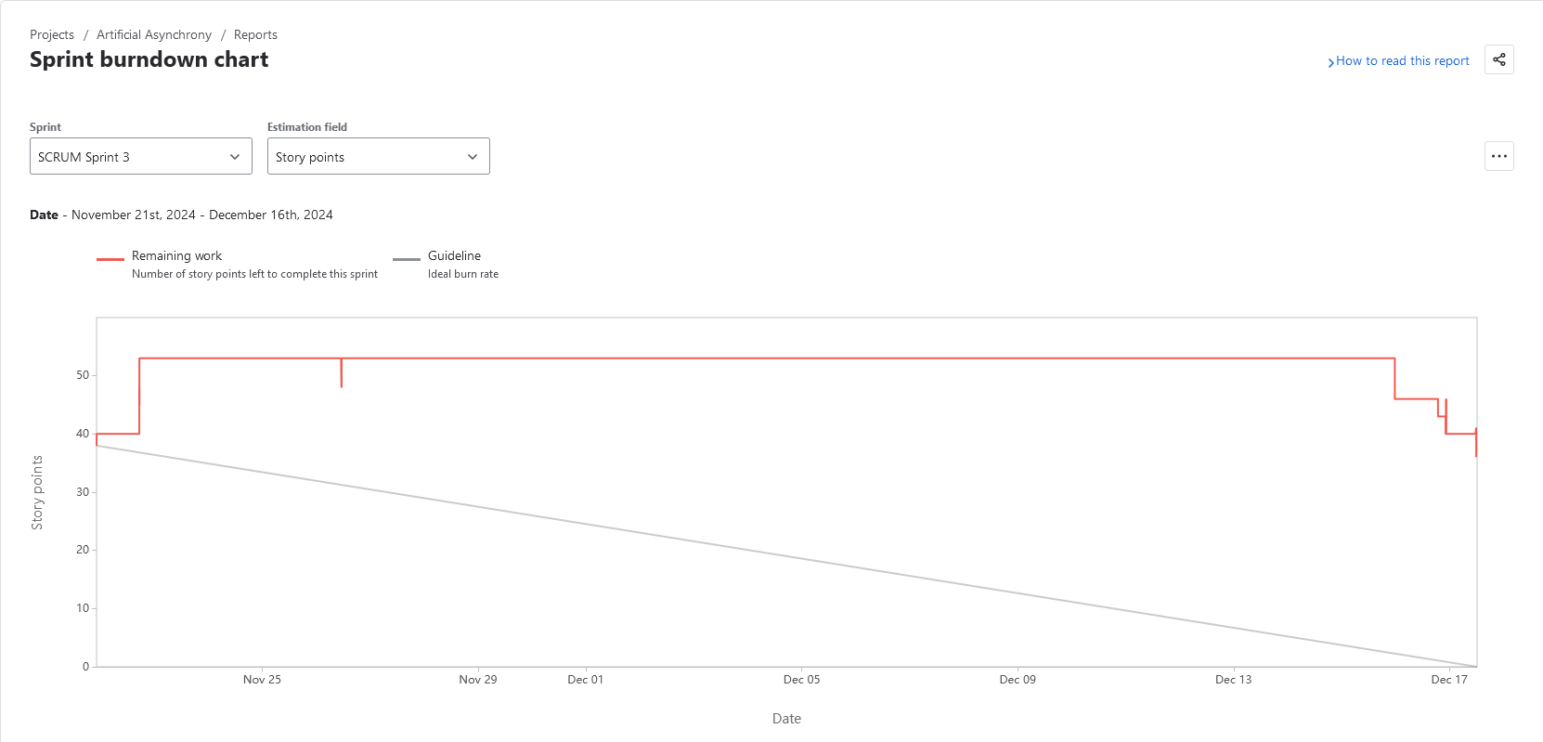
Metrics - Sprint 3 Burndown
✅

Slide 41
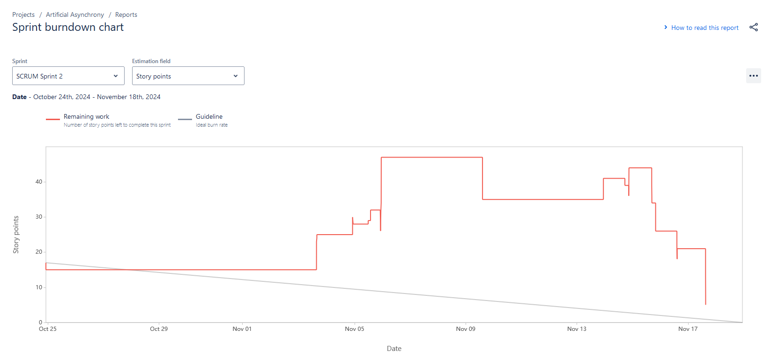
Metrics - Sprint 2 Burndown
✅

Slide 42
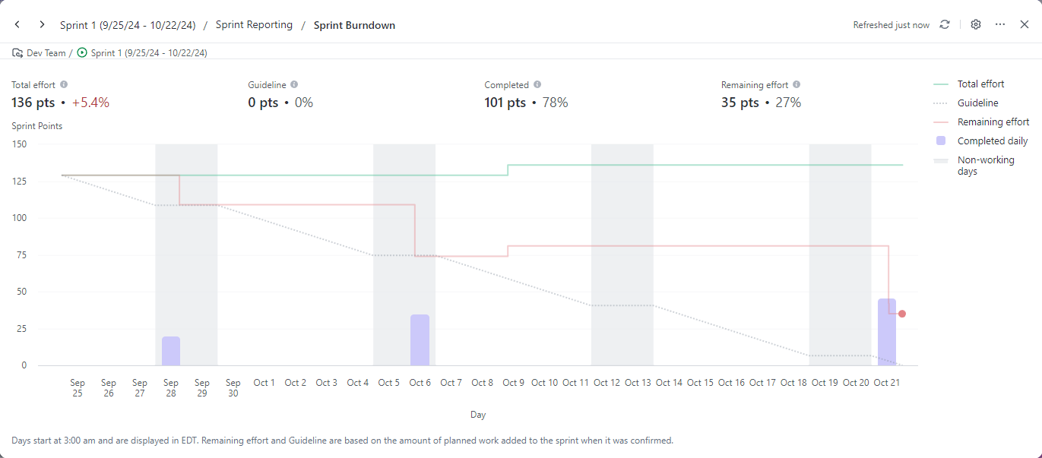
Metrics - Sprint 1 Burndown
✅

Slide 43
Metrics - Completion Ratio
✅
Sprint | Committed | Completed | Ratio
Sprint 1 | 136 | 101 | 74%
Sprint 2 | 50 | 45 | 90%
Sprint 3 | 58 | 22 | 38%

Slide 44
Burndown and Completion Notes
Work started later due to Thanksgiving Holiday in first week of sprint
Mid sprint time was split between:
Individual Assignments
Quizzes
Other class Finals
Sprint 1 burndown made with different tool
Notes:
hk

Slide 45
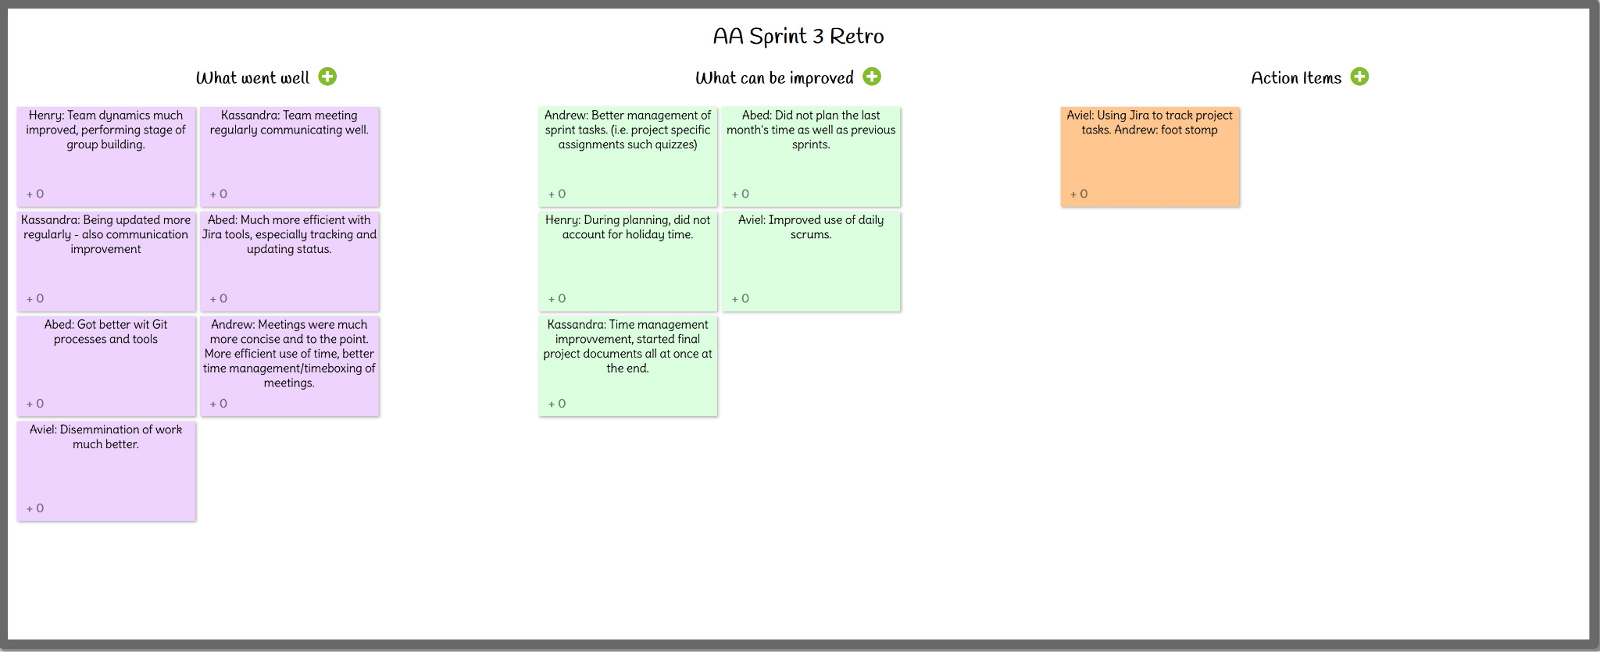
Sprint 3 Retrospective
✅
Notes:
Henry

Slide 46
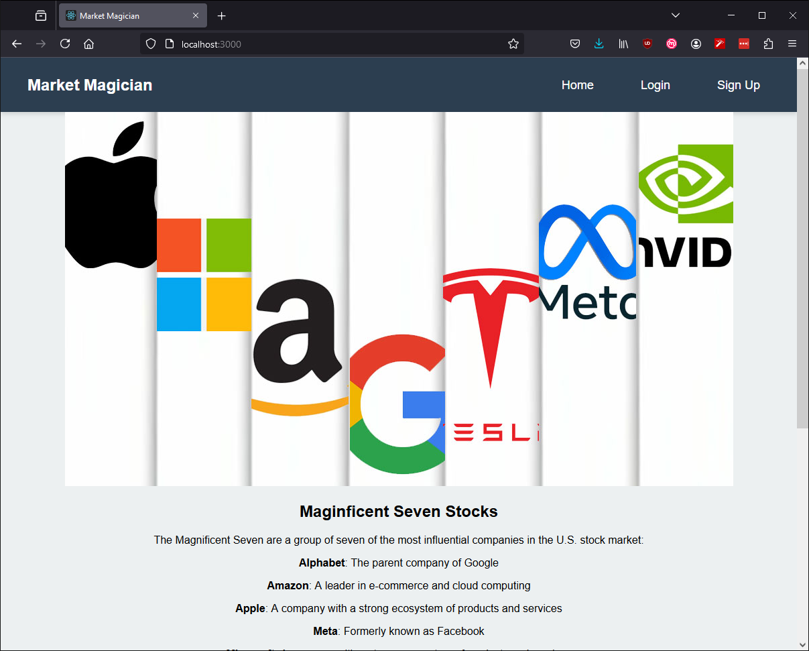
Project Demo 3
✅
Notes:
Kassandra

Slide 47
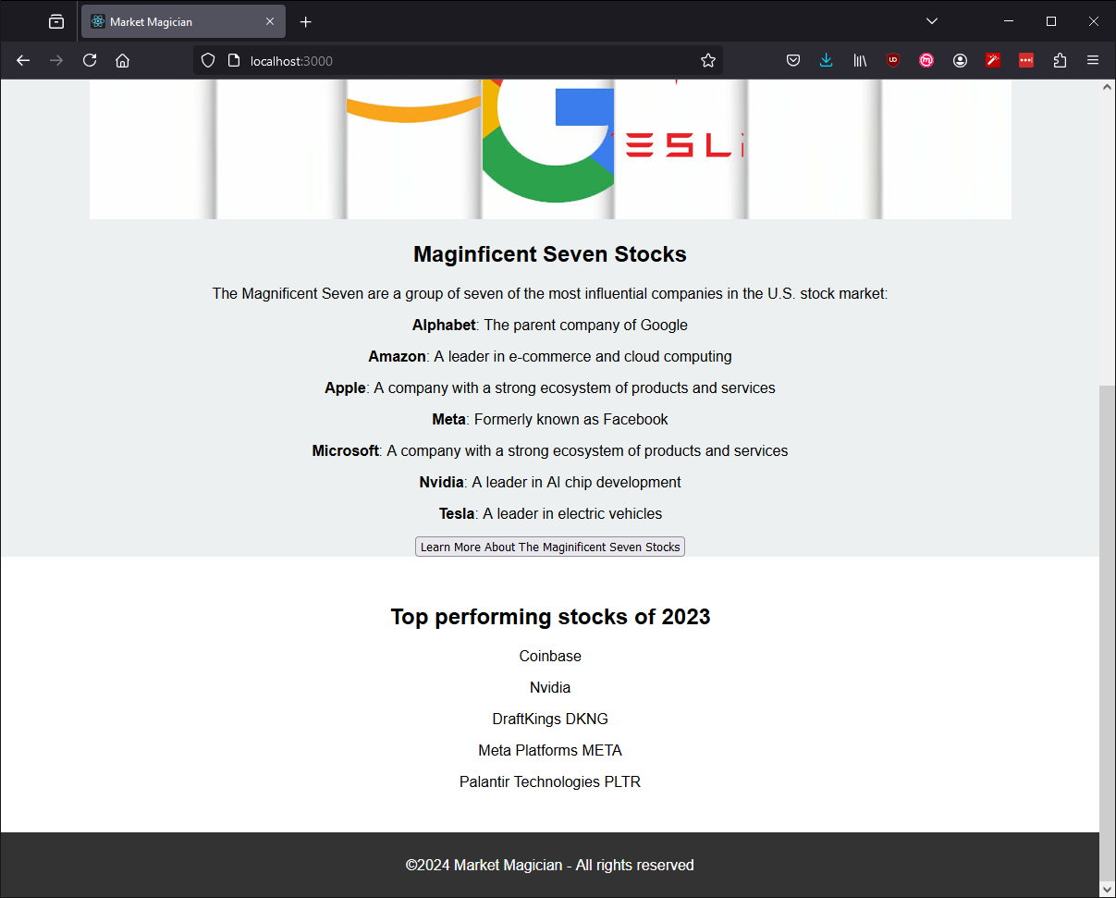
Project Demo 3
✅
Notes:
Kassandra

Slide 48
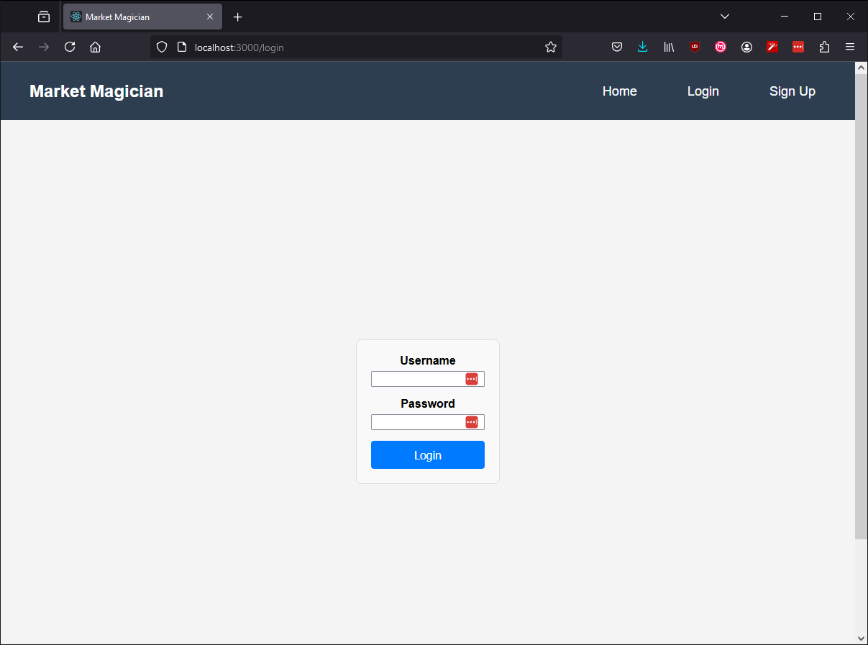
Project Demo 3
✅
Notes:
Kassandra

Slide 49
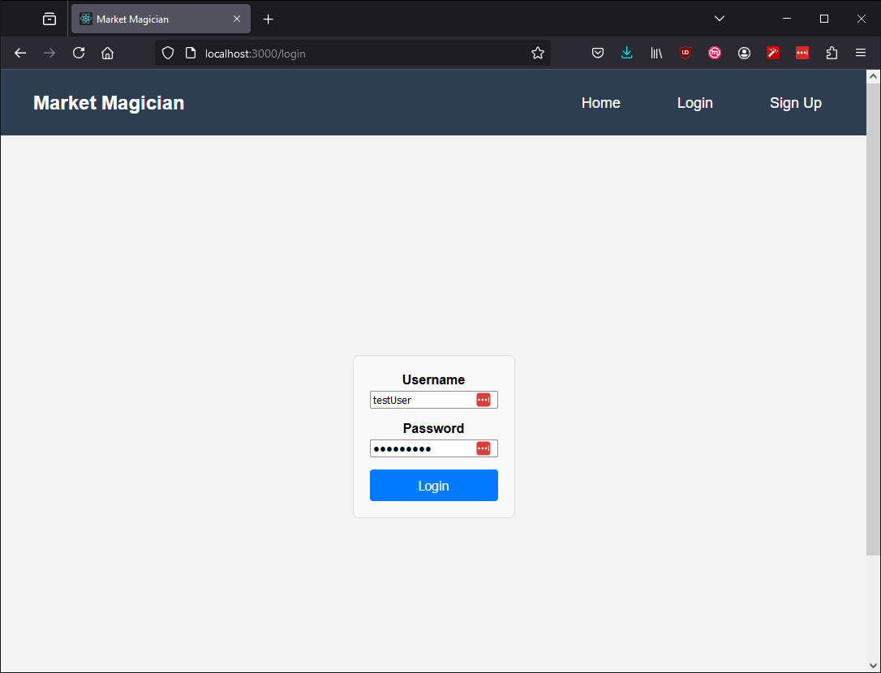
Project Demo 3
✅
Notes:
Kassandra

Slide 50
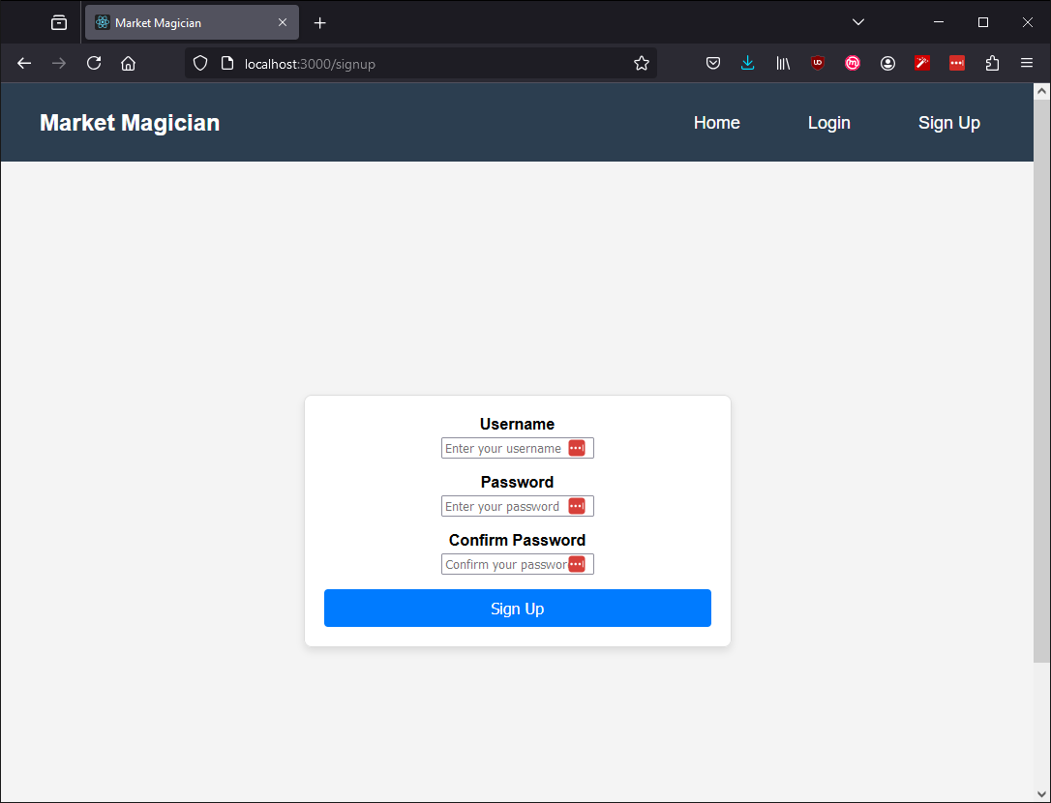
Project Demo 3
✅
Notes:
Kassandra

Slide 51
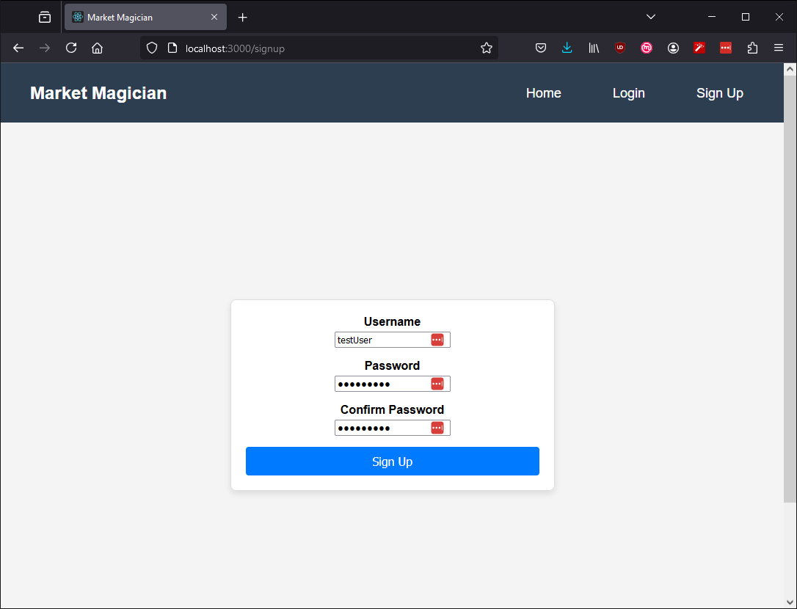
Project Demo 3
✅
Notes:
Kassandra

Slide 52
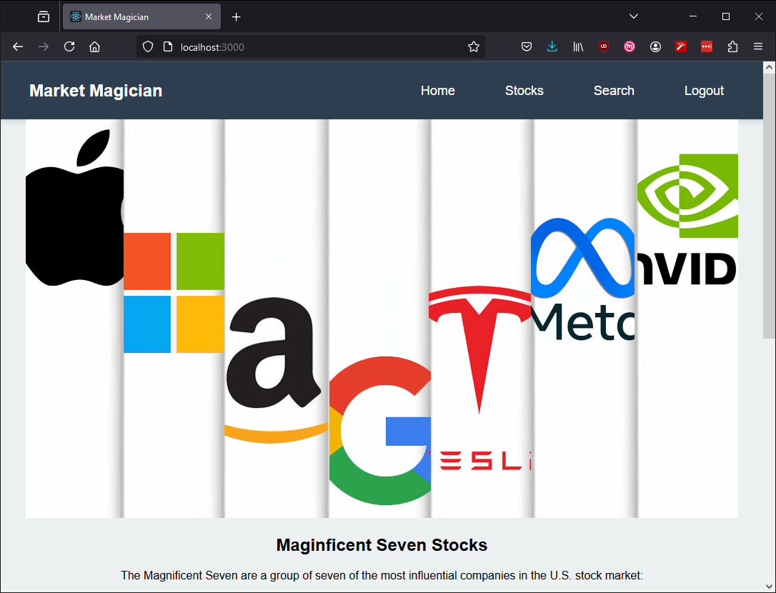
Project Demo 3
✅
Notes:
Kassandra

Slide 53
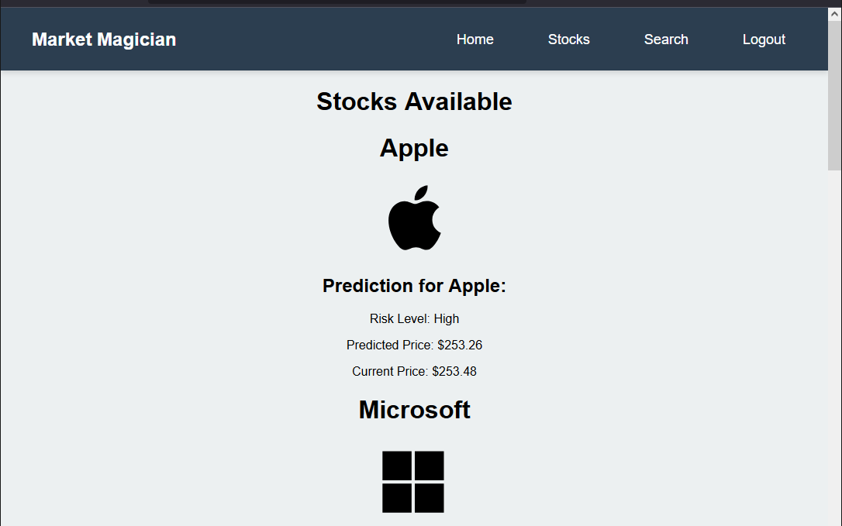
Project Demo 3
✅
Notes:
Kassandra

Slide 54
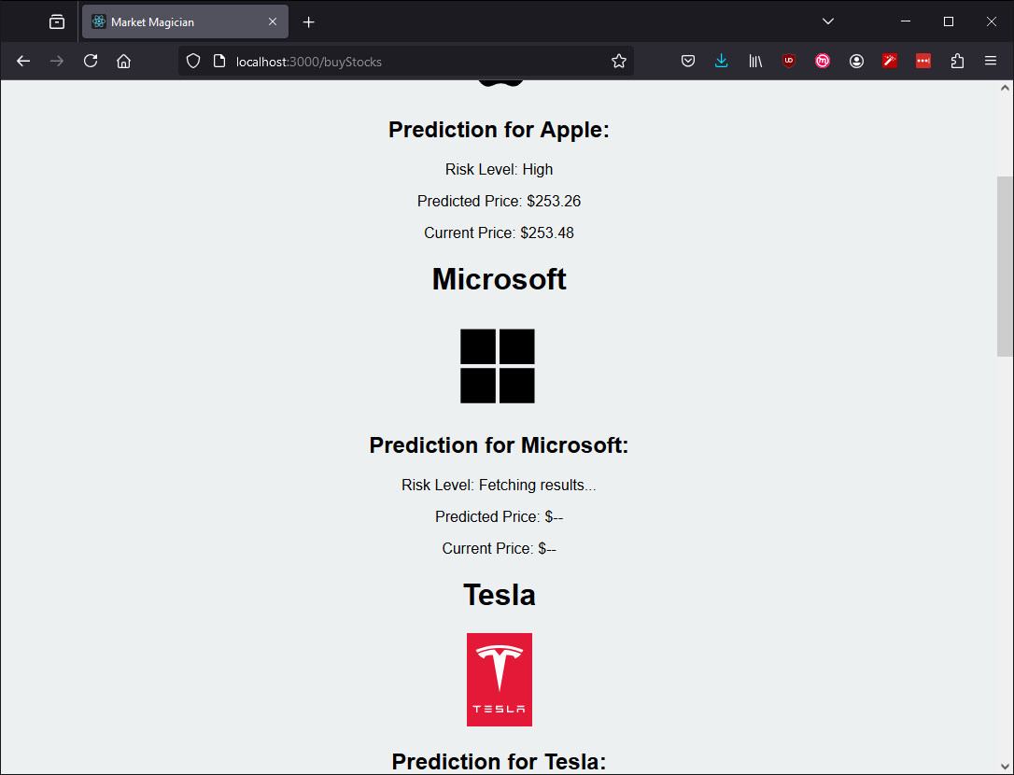
Project Demo 3
✅
Notes:
Kassandra

Slide 55
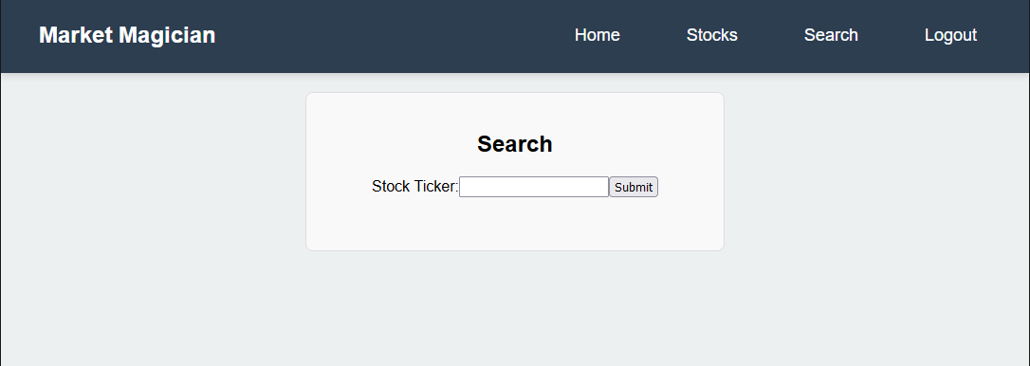
Project Demo 3
✅
Notes:
Kassandra

Slide 56
API Document
Predict Stock Prices: Uses LSTM machine learning models for accurate price predictions.
Dynamic Model Training: Automatically trains and saves models if none exist for the requested ticker.
Comprehensive Risk Analysis:
Provides risk classification (Low, Moderate, High) based on percentile thresholds.
Calculates low and high price thresholds for decision-making.

Slide 57
API Document
Endpoint Details
POST /api/predict/
Request: Send stock ticker in JSON format (e.g., { "ticker": "AAPL" }).
Response:
Predicted price, risk level, thresholds, and ticker symbol.
Example: { "ticker": "AAPL", "predicted_price": 155.50, "predicted_risk": "Moderate" }.

Slide 58
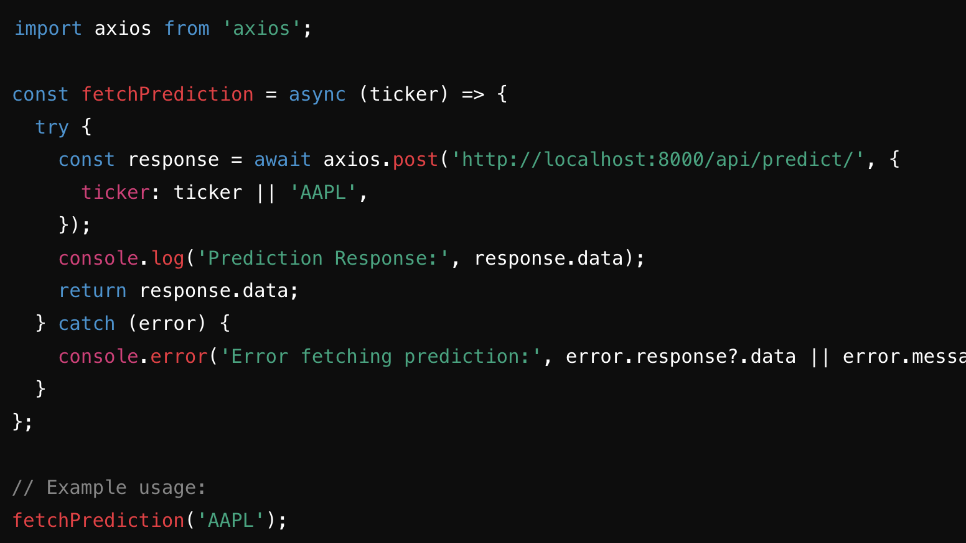
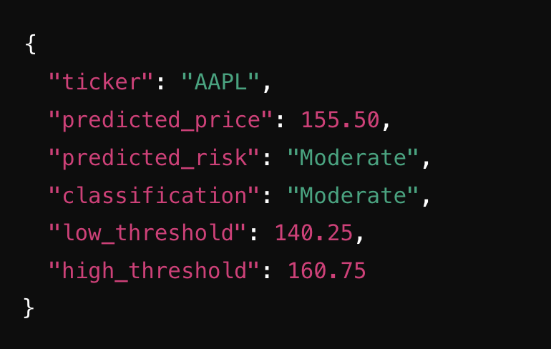
API Document Code Snippets
Code
Example Output

Slide 59
Wikipage Link
https://github.com/htmw/2024F-Artificial-Asynchrony/wiki
Notes:
avi

